Slide 1
Fort Andres Bonifacio Evangelical Church
Church Management System
Markim John Africa
Ave Jay Moradillo
Jhun Michael Tabudlong

Slide 2
Clients Profile
Fort Andres Bonifacio Evangelical Church or widely known as FABEC is a Christian church built to serve the community of the Armed Forces of the Philippines as well as the local civilians in the area to spear-head a Christ-centered, spirit-filled, and Mission-oriented Community of believers.

Slide 3
Project Objectives
This System will give the user(s) (members of the church) the benefit to access the schedule of events, online prayer request, and ministry updates of the church.
This system will also have an online registration for those who wants to be members of the church.
The administrators of this system will be given the privilege to post, review, and keep track of the reports on prayer request, membership, financial statements, events, and church ministry.

Slide 4
Purpose of the project
The purpose of the project is to provide the client with an online management system where the church can track and manage the events that are being proposed to the church by its members. Also, this projects provides an informative website that the church can use in spreading the Good News through the social media community.

Slide 5
Application system modules
1. Login System
2. Prayer Request
3. Online Membership
4. Event Registration
5. Calendar
6. News feed
7. Tracking system for their events, church needs, financial statements, etc.

Slide 6
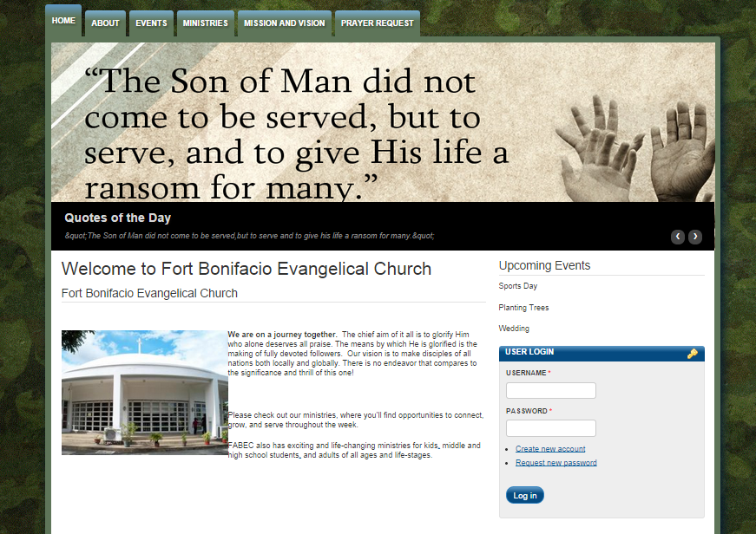
Screen Shots

Slide 7
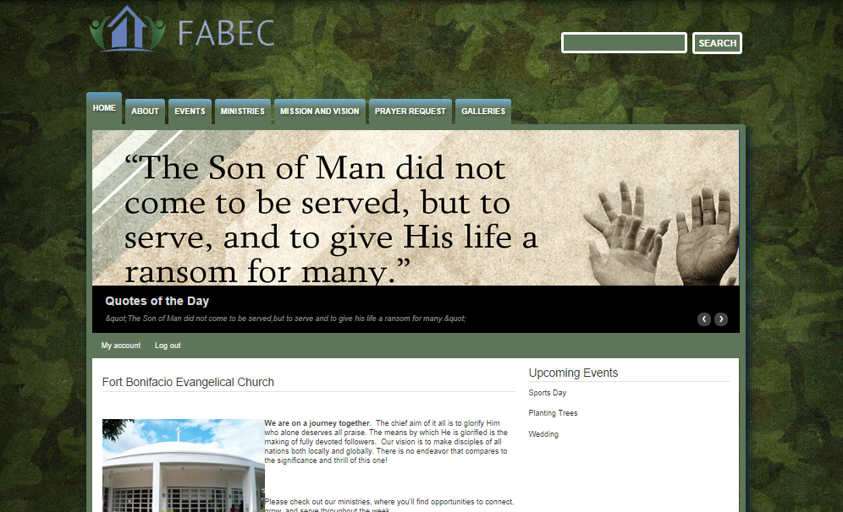
Screen Shots

Slide 8
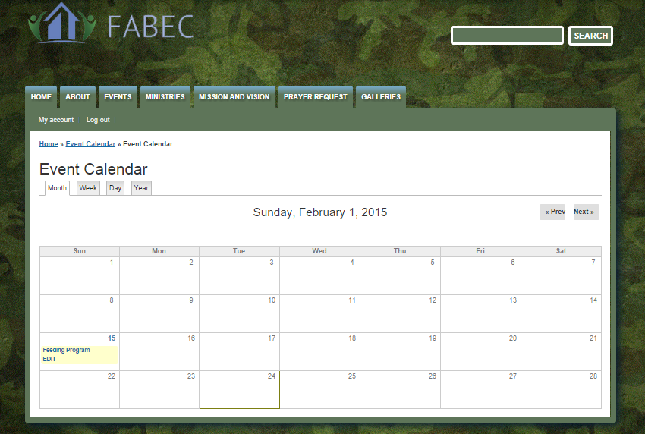
Screen Shots

Slide 9
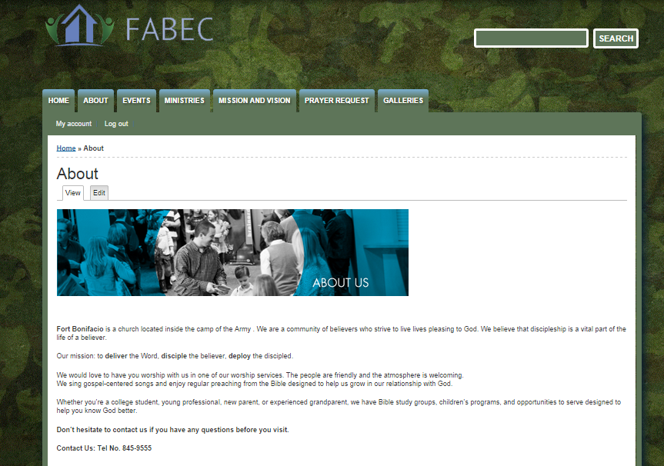
Screen Shots

